Slide 1
LECTURE # 14
SEQUENCE
  A sequence is just a list of elements usually written in a row.
  EXAMPLES
      1. 1, 2, 3, 4, 5, …
      2. 4, 8, 12, 16, 20,…
      3. 2, 4, 8, 16, 32, …
      4. 1, 1/2, 1/3, 1/4, 1/5, …
      5. 1, 4, 9, 16, 25, …
      6. 1, -1, 1, -1, 1, -1, …
  NOTE:
  The symbol “…” is called ellipsis

Slide 2
FORMAL DEFINITION
  A sequence is a function whose domain is the set of integers greater than or equal to a particular integer n₀.
  Usually this set is the set of Natural numbers {1, 2, 3, …} or the set of whole numbers {0, 1, 2, 3, …}.
  NOTATION
  We use the notation a_{n} to denote the image of the integer n, and call it a term of the sequence. Thus
  a₁, a₂, a₃, a₄, …, a_{n}, …
  represent the terms of a sequence defined on the set of natural numbers N.

Slide 3
  a₁, a₂, a₃, a₄, …, a_{n}, …
Note that a sequence is described by listing the terms of the sequence in order of increasing subscripts.

Slide 4
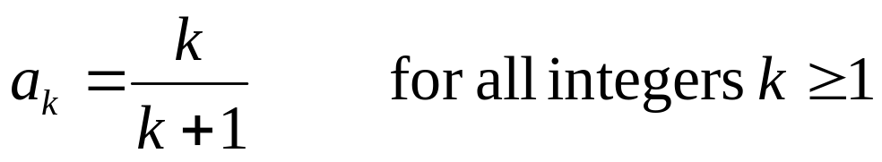
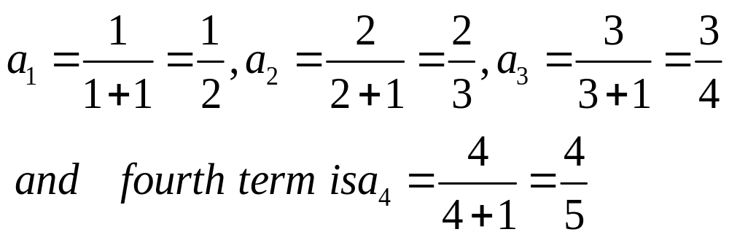
FINDING TERMS OF A SEQUENCE GIVEN BY AN EXPLICIT FORMULA
  An explicit formula or general formula for a sequence is a rule that shows how the values of a_{k} depends on k.
EXAMPLE
  Define a sequence a₁, a₂, a₃, … by the explicit formula
  The first four terms of the sequence are:

Slide 5
EXAMPLE
  Write the first four terms of the sequence defined by the formula
  b_{j} = 1 + 2^{j}, for all integers j ≥ 0
  SOLUTION
        b₀ = 1 + 2⁰ = 1 + 1 = 2
        b₁ = 1 + 2¹ = 1 + 2 = 3
        b₂ = 1 + 2² = 1 + 4 = 5
        b₃ = 1 + 2³ = 1 + 8 = 9
  REMARK
  The formula b_{j} = 1 + 2^{j,} for all integers j ≥ 0 defines an infinite sequence having infinite number of values.

Slide 6
EXERCISE
  Compute the first six terms of the sequence defined by the formula C_{n} = 1+ (-1)^{n} for all integers n ≥ 0
  SOLUTION
  C₀ = 1 + (-1)⁰ = 1 + 1 = 2
  C₁ = 1 + (-1)¹ = 1 + (-1) = 0
  C₂ = 1 + (-1)² = 1 + 1 = 2
  C₃ = 1 + (-1)³ = 1 + (-1) = 0
  C₄ = 1 + (-1)⁴ = 1 + 1 = 2
  C₅ = 1 + (-1)⁵ = 1 + (-1) = 0

Slide 7
  REMARK:
  (1) If n is even, then C_{n} = 2 and if n is odd, then C_{n} = 0
  Hence, the sequence oscillates endlessly between 2 and 0.
  (2) An infinite sequence may have only a finite number of values.

Slide 8
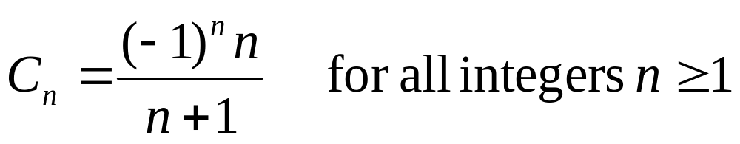
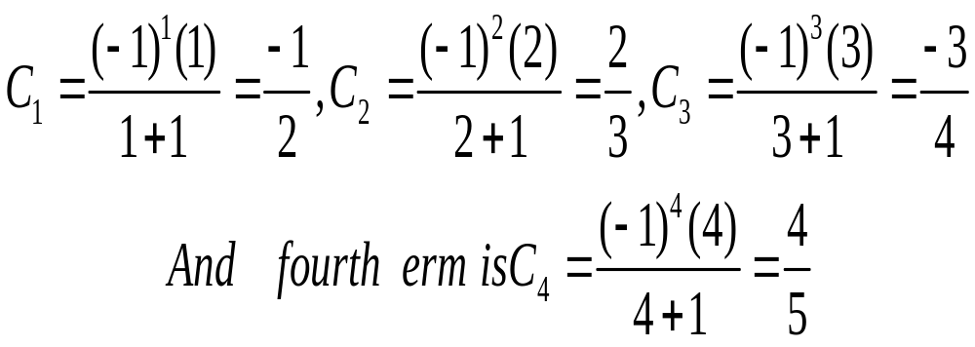
EXAMPLE
  Write the first four terms of the sequence defined by
SOLUTION
  REMARK
  A sequence whose terms alternate in sign is called an alternating sequence.

Slide 9
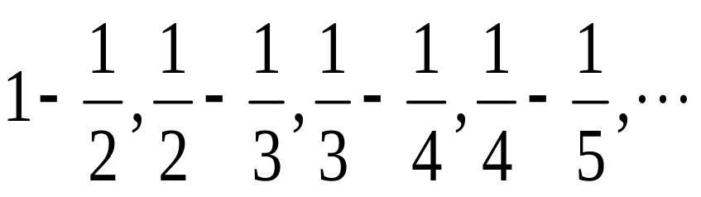
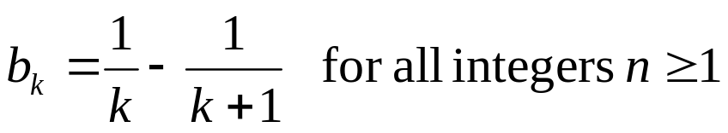
EXERCISE
  Find explicit formulas for sequences with the initial terms given:
  1. 0, 1, -2, 3, -4, 5, …
  SOLUTION
  a_{n} = (-1)^{n+1}n for all integers n ≥ 0
  2.
  SOLUTION

Slide 10
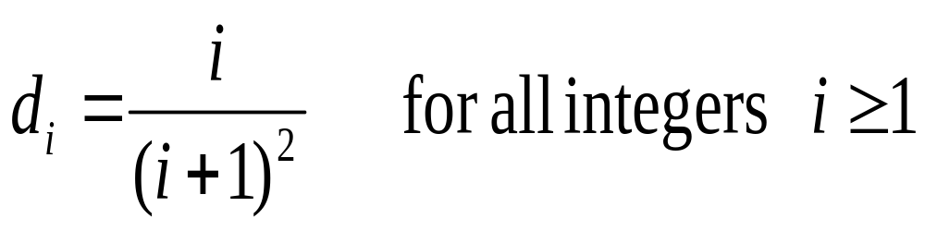
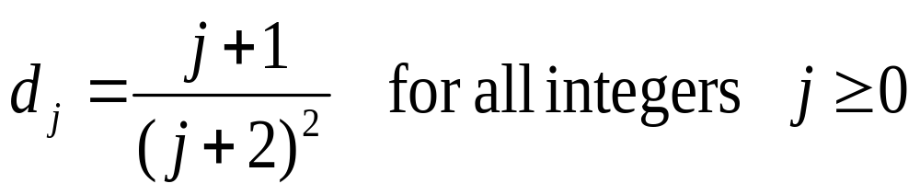
  3. 2, 6, 12, 20, 30, 42, 56, …
  SOLUTION
  C_{n} = n (n + 1) for all integers n ≥ 1
  4. 1/4, 2/9, 3/16, 4/25, 5/36, 6/49, …
  SOLUTION
OR

Slide 11
ARITHMETIC SEQUENCE
  A sequence in which every term after the first is obtained from the preceding term by adding a constant number is called an arithmetic sequence or arithmetic progression (A.P.)
  The constant number, being the difference of any two consecutive terms is called the common difference of A.P., commonly denoted by “d”.

Slide 12
  EXAMPLES
  5, 9, 13, 17, …
  (common difference = 4)
  2. 0, -5, -10, -15, … (common difference = -5)
  3. x + a, x + 3a, x + 5a, … (common difference = 2a)

Slide 13
GENERAL TERM OF AN ARITHMETIC SEQUENCE
  Let a be the first term and d be the common difference of an arithmetic sequence. Then the sequence is
  a, a+d, a+2d, a+3d, …
  If a_{i}, for i ≥ 1, represents the terms of the sequence then
  a₁ = first term = a = a + (1-1) d
  a₂ = second term = a + d = a + (2-1) d
  a₃ = third term = a + 2d = a + (3 -1) d
  By symmetry
  a_{n} = nth term = a + (n - 1)d for all integers n ≥1.

Slide 14
EXAMPLE
  Find the 20th term of the arithmetic sequence
  3, 9, 15, 21, …
  SOLUTION
  Here a = first term = 3
  d = common difference = 9 - 3 = 6
  n = term number = 20
  a₂₀ = value of 20th term = ?
  Since a_{n} = a + (n - 1) d; n ≥1
  ∴ a₂₀ = 3 + (20 - 1) 6
  = 3 + 114
  = 117

Slide 15
EXAMPLE
  Which term of the arithmetic sequence
  4, 1, -2, …, is -77
  SOLUTION
  Here a = first term = 4
  d = common difference = 1 - 4 = -3
  a_{n} = value of nth term = - 77
  n = term number = ?

Slide 16
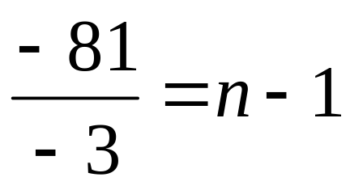
  Since
  a_{n} = a + (n - 1) d n ≥1
  ⇒ - 77 = 4 + (n - 1) (-3)
  ⇒ - 77 - 4 = (n - 1) (-3)
  27 = n – 1
  n = 28
  Hence –77 is the 28th term of the given sequence.

Slide 17
EXERCISE
  Find the 36th term of the arithmetic sequence whose 3rd term is 7 and 8th term is 17.
  SOLUTION
  Let a be the first term and d be the common difference of the arithmetic sequence.
  Then a_{n} = a + (n - 1)d n ≥ 1
  ⇒ a₃ = a + (3 - 1) d
  and a₈ = a + (8 - 1) d
  Given that a₃ = 7 and a₈ = 17.

Slide 18
  Given that a₃ = 7 and a₈ = 17.
  Therefore
  7 = a + 2d……………………(1)
  and
  17 = a + 7d………….………..(2)
  Subtracting (1) from (2), we get,
  10 = 5d
  ⇒ d = 2
  Substituting d = 2 in (1) we have
  7 = a + 2(2)
  which gives a = 3

Slide 19
  Thus, a_{n} = a + (n - 1) d
  a_{n} = 3 + (n - 1) 2
  Hence the value of 36th term is
  a₃₆ = 3 + (36 - 1) 2
  = 3 + 70
  = 73

Slide 20
GEOMETRIC SEQUENCE
  A sequence in which every term after the first is obtained from the preceding term by multiplying it with a constant number is called a geometric sequence or geometric progression (G.P.)
  The constant number, being the ratio of any two consecutive terms is called the common ratio of the G.P. commonly denoted by “r”.
  EXAMPLE
  1. 1, 2, 4, 8, 16, … (common ratio = 2)
  2. 3, - 3/2, 3/4, - 3/8, … (common ratio = - 1/2)
  3. 0.1, 0.01, 0.001, 0.0001, … (common ratio = 0.1 = 1/10)

Slide 21
GENERAL TERM OF A
GEOMETRIC SEQUENCE
  Let a be the first tem and r be the common ratio of a geometric sequence. Then the sequence is a, ar, ar², ar³, …
  If a_{i}, for i ≥ 1 represent the terms of the sequence, then
  a₁ = first term = a = ar¹⁻¹
  a₂ = second term = ar = ar²⁻¹
  a₃ = third term = ar² = ar³⁻¹
  ………………
  ………………
  a_{n} = nth term = ar^{n-1}; for all integers n ≥ 1

Slide 22
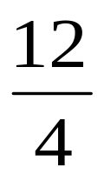
EXAMPLE
  Find the 8th term of the following geometric sequence
  4, 12, 36, 108, …
  SOLUTION
  Here a = first term = 4
  r = common ratio = = 3
  n = term number = 8
  a₈ = value of 8th term = ?
  Since a_{n} = ar^{n-1}; n ≥ 1
  ⇒ a₈ = (4)(3)⁸⁻¹
  = 4 (2187)
  = 8748

Slide 23
EXAMPLE
  Which term of the geometric sequence is 1/8 if the first term is 4 and common ratio 1/2.
  SOLUTION
  Given a = first term = 4
  r = common ratio = 1/2
  a_{n} = value of the nth term = 1/8
  n = term number = ?

Slide 24
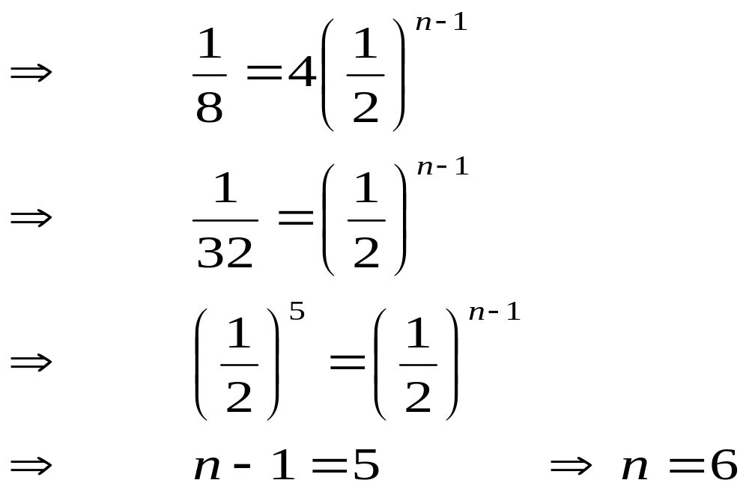
Since a_{n} = ar^{n-1} n ≥ 1
Hence 1/8 is the 6th term of the given G.P.

Slide 25
EXERCISE
  Write the geometric sequence with positive terms whose second term is 9 and fourth term is 1.
  SOLUTION
  Let a be the first term and r be the common ratio of the geometric sequence. Then
  a_{n} = ar^{n-1}; n ≥1
  Now a₂ = ar²⁻¹
  ⇒ 9 = ar………………….(1)
  Also a₄ = ar⁴⁻¹
  1 = ar³…………………(2)

Slide 26
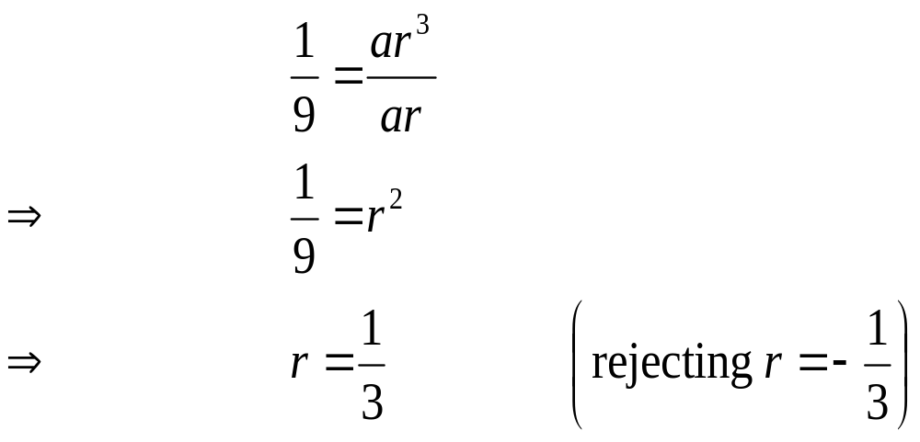
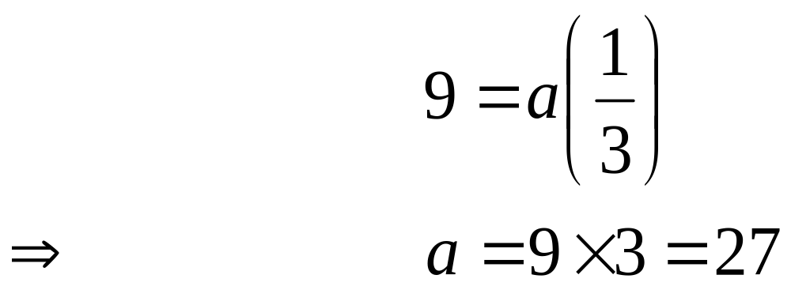
Dividing (2) by (1), we get,
Substituting r = 1/3 in (1), we get
  Hence the geometric sequence is
  27, 9, 3, 1, 1/3, 1/9, …

Slide 27
SEQUENCES IN
COMPUTER PROGRAMMING
  An important data type in computer programming consists of finite sequences known as one-dimensional arrays; a single variable in which a sequence of variables may be stored.
  EXAMPLE
  The names of k students in a class may be represented by an array of k elements “name” as:
  name [0], name[1], name[2], …, name[k-1]

